Slide 1
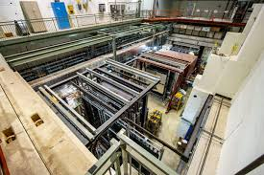




Determination of 𝜓′ contamination for DY Absolute Cross-Section Study Chatura Kuruppu
Notes:
Hi! This is the weekly update until 8th of August

Slide 2
Overview
Motivation
Event selection criteria
Step-By-Step procedure
Determination of 𝝍′ contamination for each xF bin
Difficulties encountered when studying low xF region
Conclusions and Discussion (Needs collaboration input)
Notes:
Today I am going to address mainly 2 comments received:
During the Monday meeting I have presented the mass spectra I created by using my script.
There were mainly 2 comments:

Slide 3
Event Selection Criteria
Files Used:
Data:
merged_RS67_3089LH2.root [TTree: result (data events) TTree: result_mix (NMSU mixed events)]
merged_RS67_3089flask.root [TTree: result (flask events) TTree: result_mix (flask mixed events)]
MC:
mc_drellyan_LH2_M027_S002_messy_occ_pTxFweight_v2.root
mc_jpsi_LH2_M027_S002_messy_occ_pTxFweight_v2.root
mc_psiprime_LH2_M027_S002_messy_occ_pTxFweight_v2.root
Event Selection used:
TCut dataCutNoMass = chuckCutsPositive_2111v42_tmp && chuckCutsNegative_2111v42_tmp && chuckCutsDimuon_2111v42 && physicsCutsNoMass_2111v42 && occCuts_2111v42 && "mass<8.8";
Reweight Scheme: “Reweight”
Notes:
Today I am going to address mainly 2 comments received:
During the Monday meeting I have presented the mass spectra I created by using my script.
There were mainly 2 comments:

Slide 4
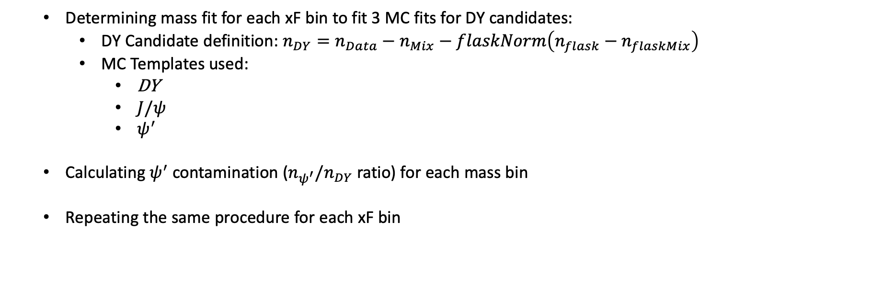
Procedure
Determining mass fit for each xF bin to fit 3 MC fits for DY candidates:
DY Candidate definition: $n_{DY}=n_{Data}−n_{Mix}−flaskNorm\left(n_{flask}−n_{flaskMix}\right)$
MC Templates used:
DY
$J/ψ$
$ψ^{′}$
Calculating $ψ^{′}$ contamination ($n_{ψ^{′}}/n_{DY}$ ratio) for each mass bin
Repeating the same procedure for each xF bin
Notes:
Today I am going to address mainly 2 comments received:
During the Monday meeting I have presented the mass spectra I created by using my script.
There were mainly 2 comments:

Slide 5

Determination of $ψ^{′}$Contamination for each xF bin
Notes:
It all began with

Slide 6
Determination of $ψ^{′}$Contamination for each xF bin
Notes:
It all began with

Slide 7
Determination of $ψ^{′}$Contamination for each xF bin
Notes:
It all began with

Slide 8
Determination of $ψ^{′}$Contamination for each xF bin
Notes:
It all began with

Slide 9
Determination of $ψ^{′}$Contamination for each xF bin
Notes:
It all began with

Slide 10
Determination of $ψ^{′}$Contamination for each xF bin
Notes:
It all began with

Slide 11
Difficulties when studying low xF region
Notes:
So, when it comes to the upcoming DNP meeting I am planning to present the absolute cross-section measurements for both LH2 and LD2 targets with different x_F bins.
Speaking of the timeline, we have 88 days and based on the disscussion with Kenichi I was advised to prepare a technote that clearly discribes the analysis procedure used to calculate the cross-section and that requires to circulate prior to 28 days and I will release the presentation including all the plots prior to 14 days of the conference.
After that I will address the comments received from the collaboration.

Slide 12
Difficulties when studying low xF region (Continued…)
Notes:
So, when it comes to the upcoming DNP meeting I am planning to present the absolute cross-section measurements for both LH2 and LD2 targets with different x_F bins.
Speaking of the timeline, we have 88 days and based on the disscussion with Kenichi I was advised to prepare a technote that clearly discribes the analysis procedure used to calculate the cross-section and that requires to circulate prior to 28 days and I will release the presentation including all the plots prior to 14 days of the conference.
After that I will address the comments received from the collaboration.

Slide 13
Difficulties when studying low xF region (Continued…)
Notes:
So, when it comes to the upcoming DNP meeting I am planning to present the absolute cross-section measurements for both LH2 and LD2 targets with different x_F bins.
Speaking of the timeline, we have 88 days and based on the disscussion with Kenichi I was advised to prepare a technote that clearly discribes the analysis procedure used to calculate the cross-section and that requires to circulate prior to 28 days and I will release the presentation including all the plots prior to 14 days of the conference.
After that I will address the comments received from the collaboration.

Slide 14
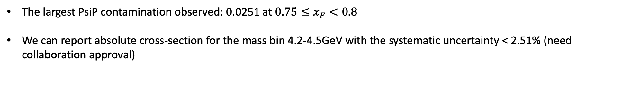
Conclusions and Discussion
The largest PsiP contamination observed: 0.0251 at $0.75≤x_{F}<0.8$
We can report absolute cross-section for the mass bin 4.2-4.5GeV with the systematic uncertainty < 2.51% (need collaboration approval)
Notes:
So, when it comes to the upcoming DNP meeting I am planning to present the absolute cross-section measurements for both LH2 and LD2 targets with different x_F bins.
Speaking of the timeline, we have 88 days and based on the disscussion with Kenichi I was advised to prepare a technote that clearly discribes the analysis procedure used to calculate the cross-section and that requires to circulate prior to 28 days and I will release the presentation including all the plots prior to 14 days of the conference.
After that I will address the comments received from the collaboration.

